Slide 1
Econometrics & Statistical Models
Group Member:
Michael WARNER
Jing Fei XU

Slide 2
01
02
INTRODUCTION
Exploratory Data Analysis
03
04
Logistic Regression Model
CONCLUSION
- aim of the project
- roadmap of the project
- data source
- data cleaning
- exploratory data analysis
- justification of the methodology used
- model creation process
- results and recommendations

Slide 3
01.
INTRODUCTION

Slide 4
AIM OF THE PROJECT
Predict the cancellation of hotel bookings

Slide 5
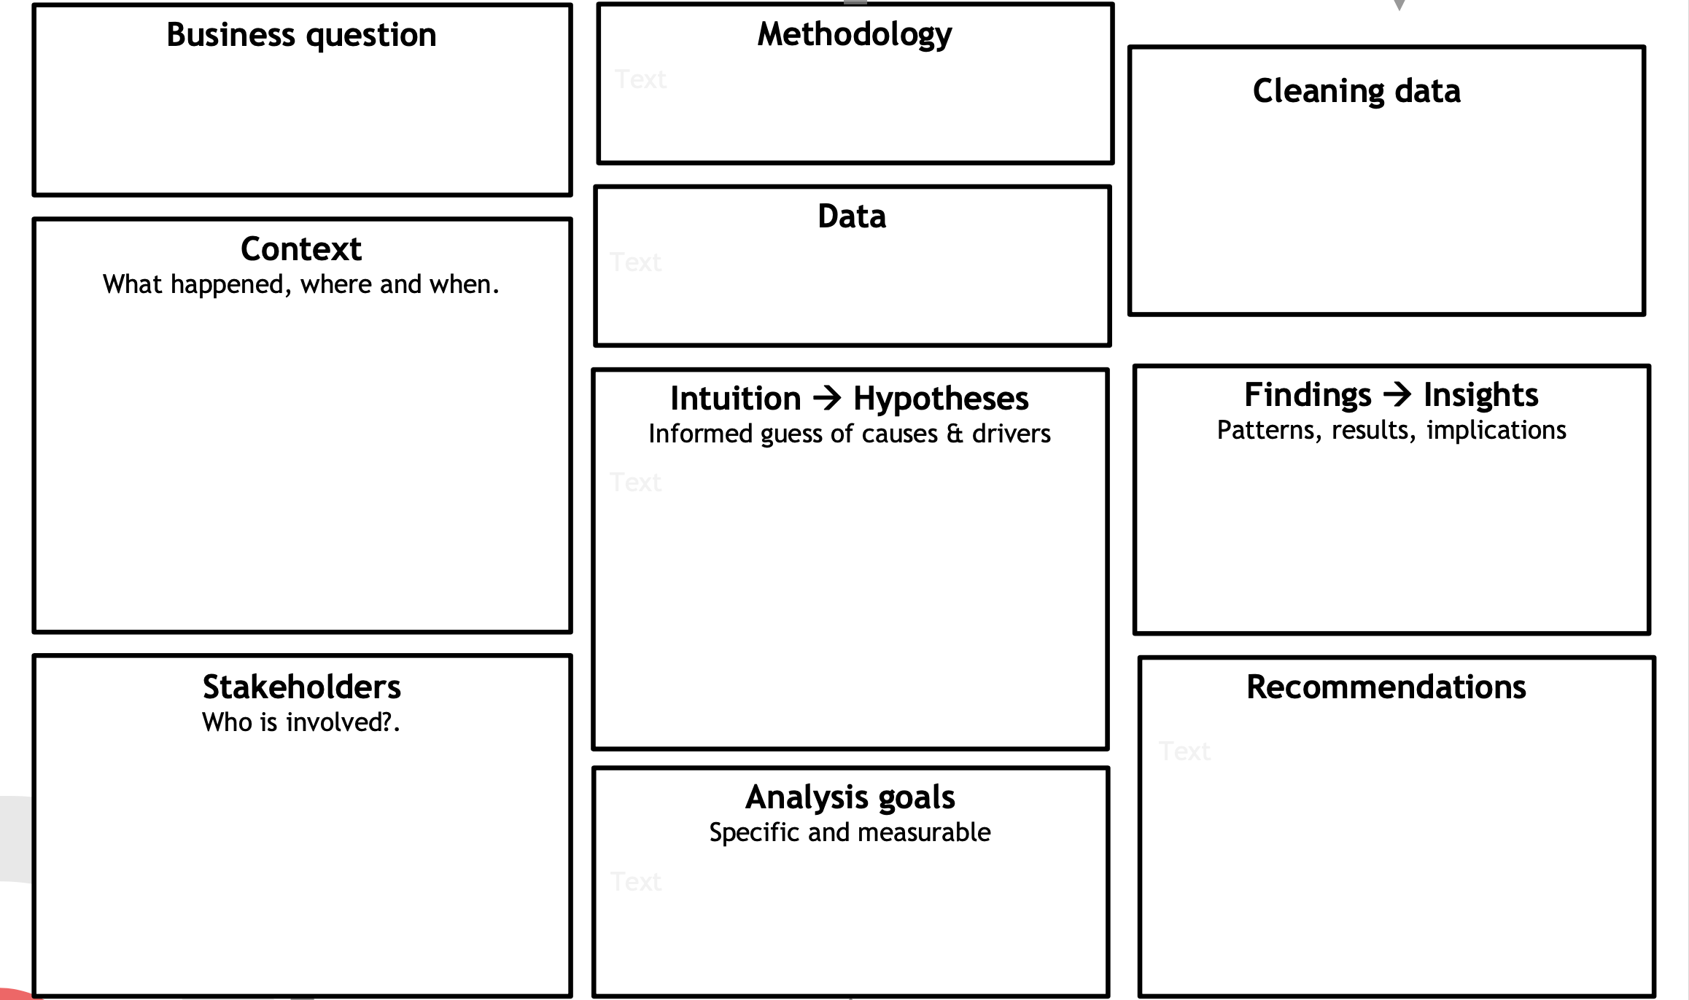
ROADMAP OF THE PROJECT
MERCURY
VENUS
Exploratory data analysis to check the quality of the data and highlight variables linked to the cancellation / Regression analysis.
The hotels seek to know if a guest will actually come.
The deletion of unnecessary columns, along with removing missing values.
Bookings due to arrive between the 1st of July of 2015 and the 31st of August 2017.
The hotels want to decrease the cancellation rate of clients and improve the hotel experiences.
Cancellation rates are tied to cost or the hotel changing something in the booking for the client.
Please view slide 43 for our findings and insights.
Mercury is the closest planet to the Sun and the smallest one in the Solar System—it’s only a bit larger than our Moon. The planet’s name has nothing to do with the liquid metal, since it was named after the Roman messenger god, Mercury
Venus has a beautiful name and is the second planet from the Sun. It’s terribly hot—even hotter than Mercury—and its atmosphere is extremely poisonous. It’s the second-brightest natural object in the night sky after the Moon
Please view slide 53 for our recommendations.
Hotels and guests
Highlight the criteria linked to the cancellation. Check if they are justified.

Slide 6
DATA SOURCE
LINK: https://www.kaggle.com/jessemostipak/hotel-booking-demand
The dataset contains data from two different hotels, one is a Resort hotel (H1) and the other is a City hotel (H2).
There’re 32 variables describing the 40,060 observations of H1 and 79,330 observations of H2.
It comprehends bookings due to arrive between the 1st of July of 2015 and the 31st of August 2017, including bookings that effectively arrived and bookings that were canceled.

Slide 7
02.
Exploratory Data Analysis

Slide 8
VARIABLES DESCRIPTION
Variable | Type | Description
hotel | Factor | Type of hotels: resort & city hotel
is_canceled | Factor | Value indicating if the booking was canceled (1) or not (0)
lead_time | Integer | Number of days that elapsed between the entering date of the booking and the arrival date
arrival_date_year | Factor | Year of arrival date
arrival_date_month | Factor | Month of arrival date with 12 categories: “January” to “December”
arrival_date_week_number | Integer | Week number of the arrival date
arrival_date_day_of_month | Integer | Day of the month of the arrival date
stays_in_weekend_nights | Integer | Number of weekend nights (Saturday or Sunday) the guest stayed or booked to stay at the hotel

Slide 9
VARIABLES DESCRIPTION
Variable | Type | Description
stays_in_week_nights | Integer | Number of week nights (Monday to Friday) the guest stayed or booked to stay at the hotel
adults | Integer | Number of adults
children | Integer | Number of children
babies | Integer | Number of babies
meal | Factor | Type of meal booked
country | Factor | Country of origin
market_segment | Factor | Market segment designation. The term “TA” means “Travel Agents” and “TO” means “Tour Operators”
distribution_channel | Factor | Booking distribution channel

Slide 10
VARIABLES DESCRIPTION
Variable | Type | Description
is_repeated_guest | Factor | Value indicating if the booking name was from a repeated guest (1) or not (0)
previous_cancellations | Integer | Number of previous bookings that were cancelled by the customer prior to the current booking
previous_booking_not_canceled | Integer | Number of previous bookings not cancelled by the customer prior to the current booking
reserved_room_type | Factor | Code of room type reserved
assigned_room_type | Factor | Code for the type of room assigned to the booking
booking_changes | Integer | Number of changes/amendments made to the booking
deposit_type | Factor | Indication on if the customer made a deposit to guarantee the booking
agent | Character | ID of the travel agency that made the booking

Slide 11
VARIABLES DESCRIPTION
Variable | Type | Description
company | Character | ID of the company/entity that made the booking or responsible for paying the booking
days_in_waiting_list | Integer | Number of days the booking was in the waiting list before it was confirmed to the customer
customer_type | Factor | Type of booking, assuming one of four categories
adr | Numeric | Average Daily Rate
required_car_parking_spaces | Integer | Number of car parking spaces required by the customer
total_of_special_requests | Integer | Number of special requests made by the customer
reservation_status | Factor | Reservation last status
reservation_status_date | Date | Date at which the last status was set

Slide 12
Data Cleaning 02.1

Slide 13
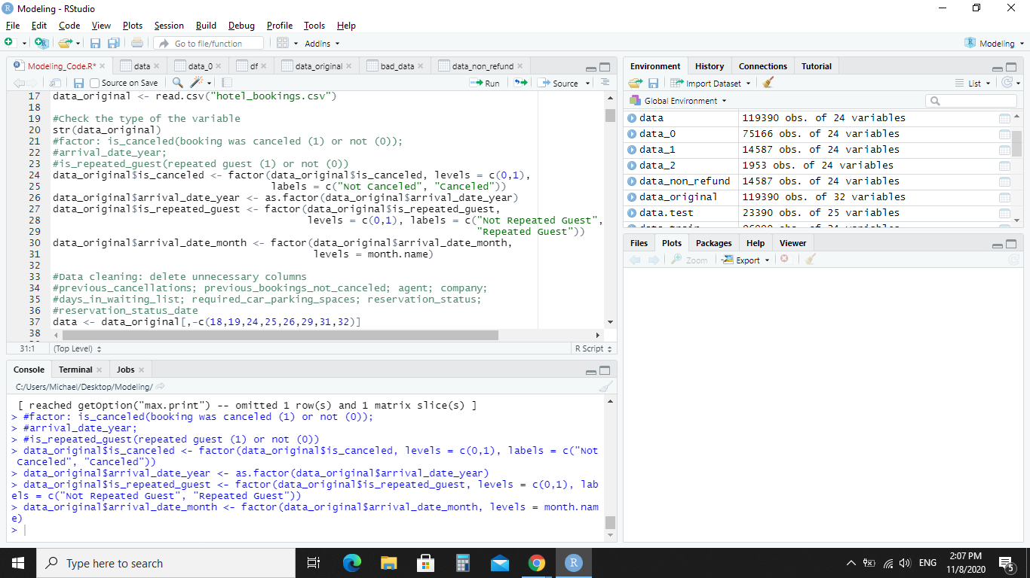
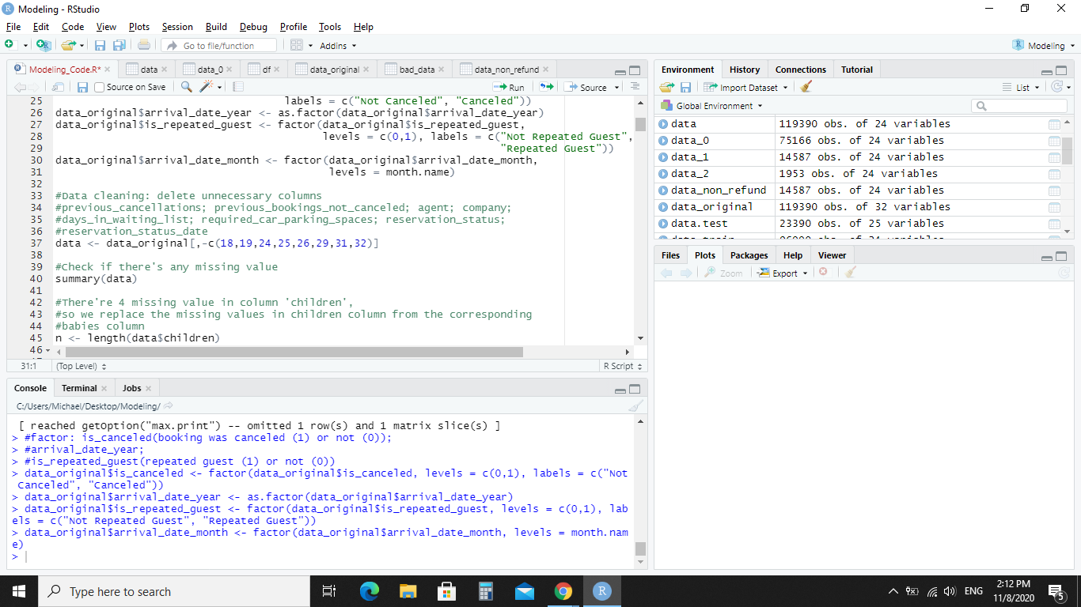
Cleaning
Step 1:
Data columns: is_canceled, arrival_date_year, is_repeated_guest, arrival_date_month, all were transformed into factors in order to be used in the analysis.
Step 2:
Deletion of unnecessary columns was taken place:

Slide 14
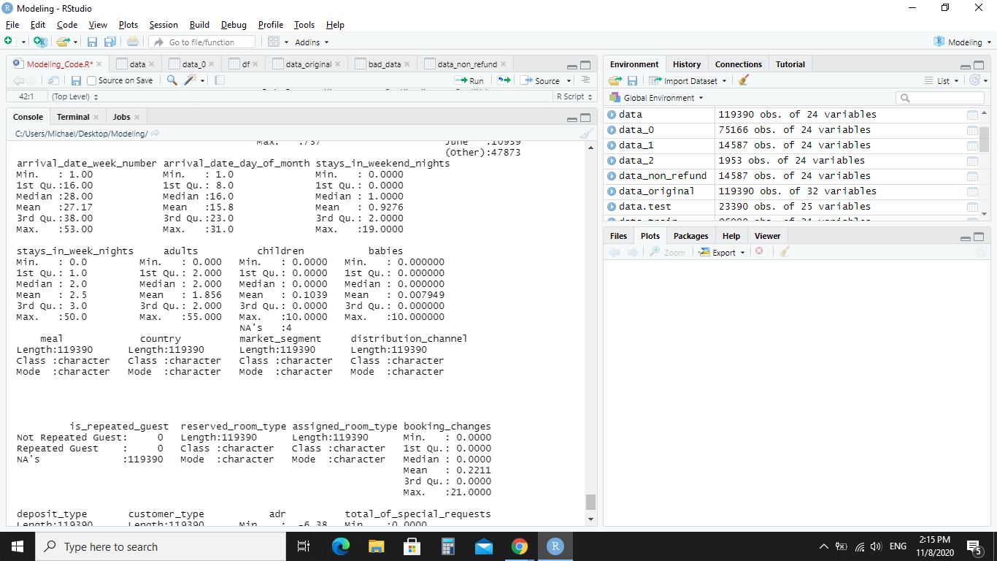
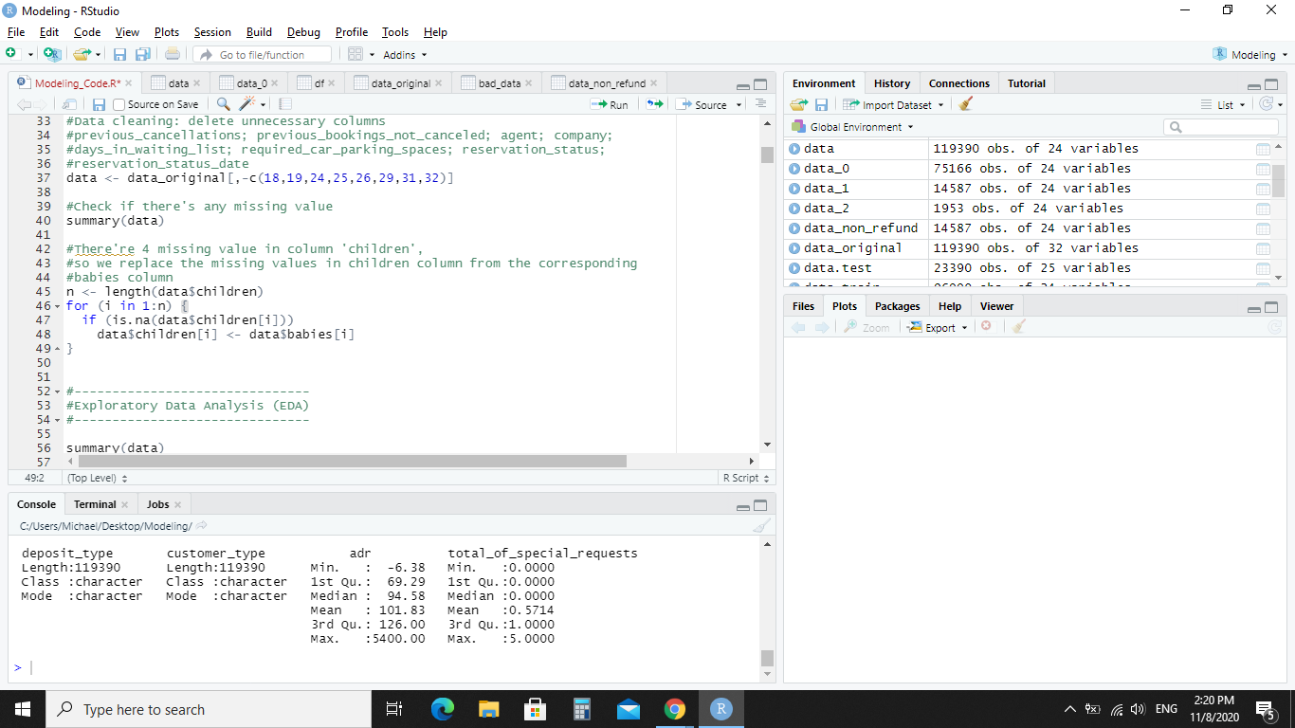
Cleaning Continued
Step 3:
Checking for missing values
Only the column “children” had NA values
Step 4:
After checking them for problems, they were filled with their data equivalent for babies.
Step 5:
We fixed an entry error for meals, undefined meal were supposed to be defined as SC.
No other cleaning steps are required.

Slide 15
Deep Exploratory Data Analysis
02.2

Slide 16
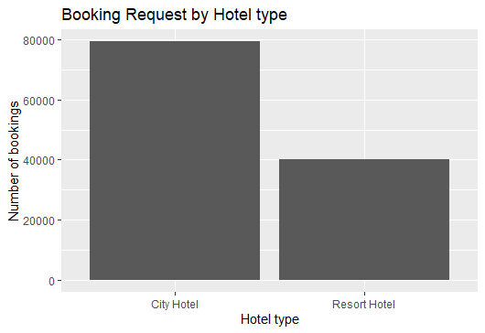
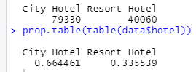
EDA - Hotel Breakdown and Cancellation
We can see that in our data set we are receiving information from two unique locations, City Hotel and Resort Hotel.
The break down of each hotel is City Hotel has 79330 bookings and Resort Hotel has 40060 bookings.
The City Hotel accounts for 66.45% of all bookings requests and Resort Hotel accounts for 33.55%.

Slide 17
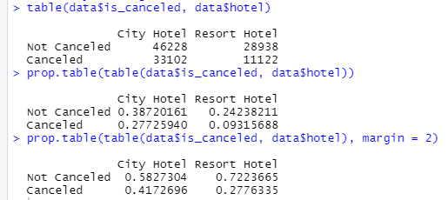
EDA - Hotel Breakdown and Cancellation
The total percentage of cancellations to non cancellations is 37.04% to 62.96%.
For over all statistics, City Hotel has the most cancellations with 27.73% and Resort Hotel has the least with 9.32%.
For each hotels individual bookings, 41.73% of City Hotel’s bookings are canceled. While 27.76% of Resort Hotel bookings are canceled.

Slide 18
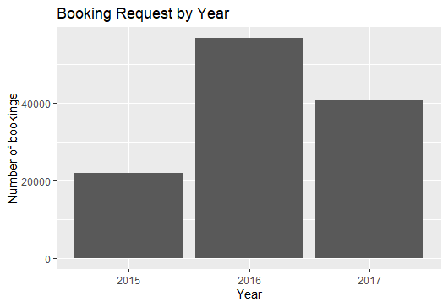
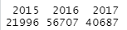
EDA - Requests by year
The company had a huge increase in booking requests in 2016, then a decrease in 2017.
Based on our investigation there is no clear evidence as to why, and there seems to be no data errors

Slide 19
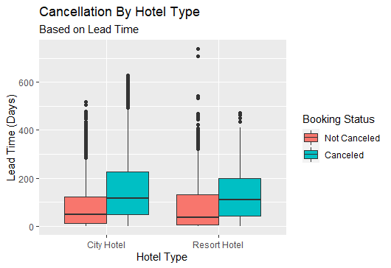
EDA - Lead Time and Cancellation
We checked the relationship between the lead time of booking a reservation and its affect on whether a cancellation will happen.
It is shown that the more time in advance someone books a room, the more likely they are to cancel their reservation.

Slide 20
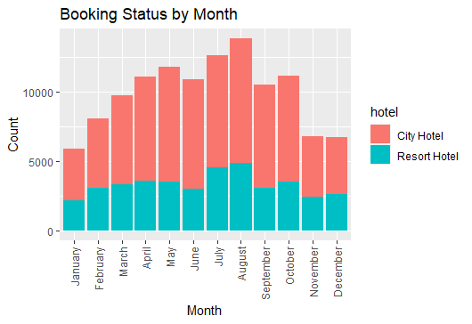
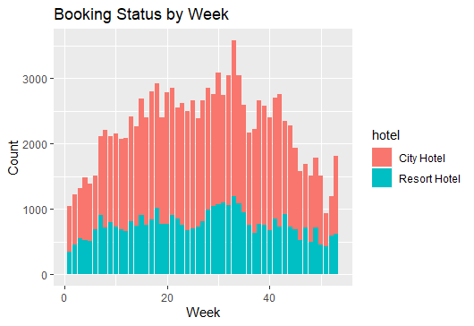
EDA - Arrival Date, per Hotel
The booking status by month shows that during the spring and summer months bookings increase, with a decrease in fall and winter.
Booking status by a week to week break down follows the same patterns as a monthly break down. The spike at week 33 corresponds to August, which is the highest booked month.

Slide 21
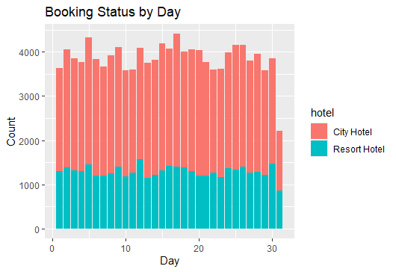
EDA - Arrival Date, per Hotel
The booking status by day does not have anything that stands out as potential errors. The drop off at day 31 corresponds to the fact that only 7 months have 31 days.
Overall there is no massive difference between the arrival day, week or month per hotel, the trends follow the logical idea of spring and summer months having more clients and having less clients in the fall and winter.

Slide 22
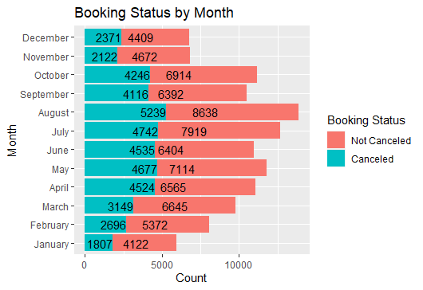
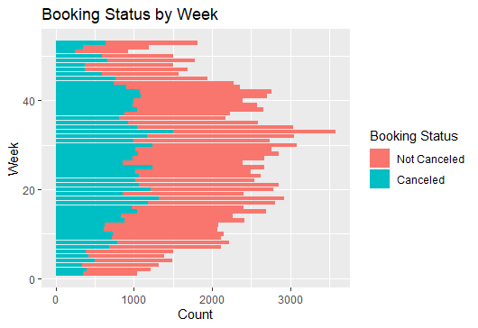
EDA - Cancellation Based on Arrival
There is nothing that can be inferred from the cancellations based on month or week, there is no unique increase in the data as the cancellation rates increase correspondingly with the overall booking increase.

Slide 23
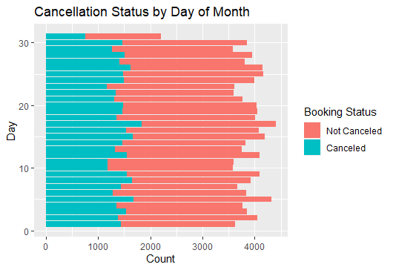
EDA - Cancellation Based on Arrival
There is also no direct connection with cancellation and not canceling based on the day of the month the arrival takes place.
To make sure there was nothing standing out, the percentage of not canceled to canceled was compared across year, month and day.
In all three cases there were no outliers.

Slide 24
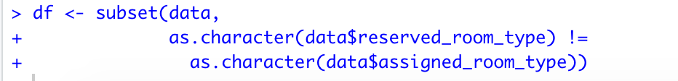
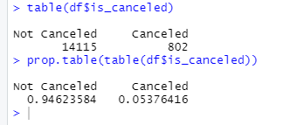
EDA - Room Allocation
It was looked into to see if there was an increase in room cancelations when the client requested one room type but was given a different room.
There is not an obvious increase of cancellations as this only has a cancellation percentage of 5.38% compared to the overall cancellation rate of 37.04%

Slide 25
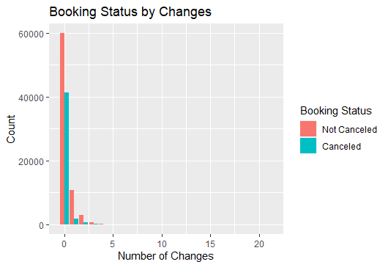
EDA - Number of Booking Changes
Most of guests didn't make any changes to the booking and the number of changes that happens to a booking does not increase the amount of cancellations that happen.

Slide 26
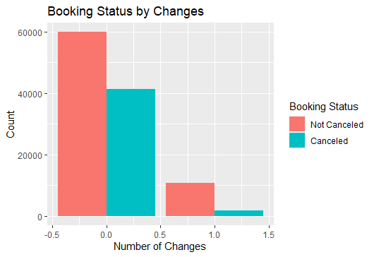
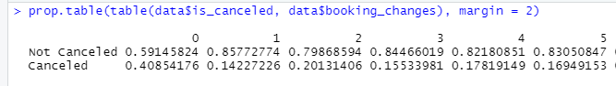
EDA - Number of Booking Changes
One thing that does stand out is that after there was one change made to the booking of the room, the percentage of cancellation decreased from 40.85% to 14.23%.
Although at two changes there was a percentage increase of cancellations, then a decrease again. Sadly based on our data, we do not know if the changes are coming from the hotel or the clients.

Slide 27
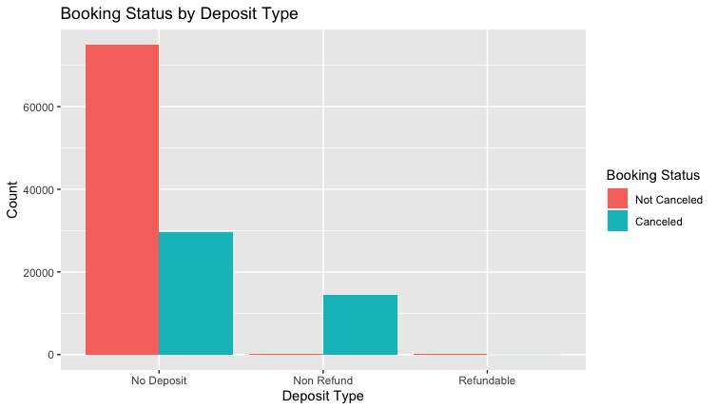
EDA - Deposit Type
Next, the type of deposit variable was checked to see if that had a connection to cancellations or not.
It was seen that most of the bookings that had a deposit were cancelled, 99.36%. This was seen as an anomaly as this is incredible high percentage for people to be willing to lose money.

Slide 28
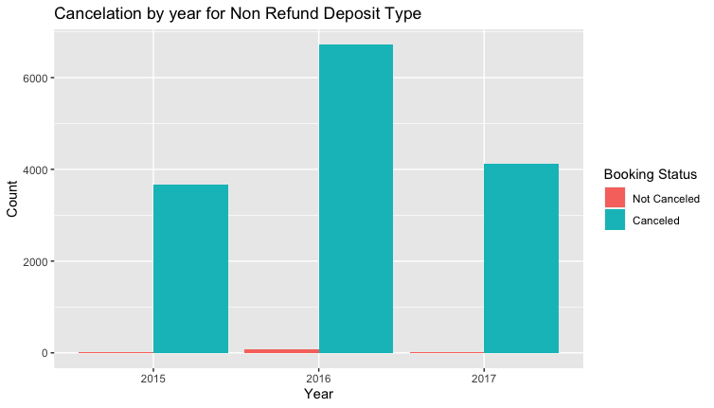
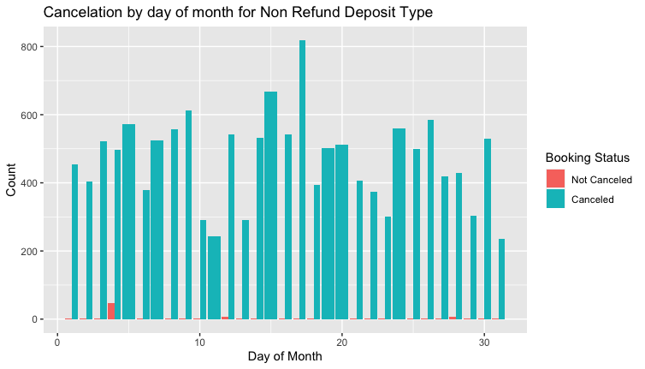
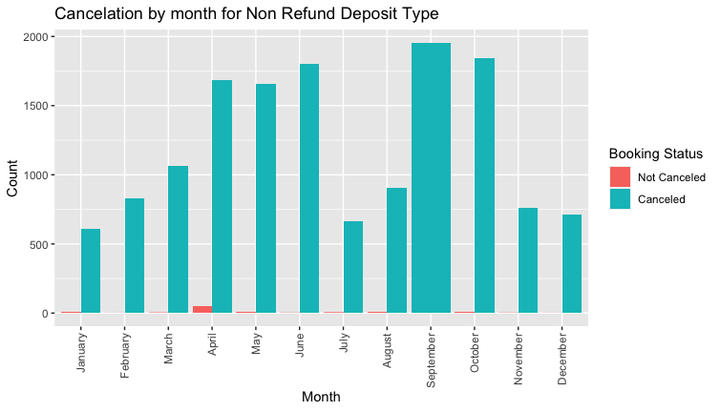
EDA - Deposit type investigated
It was investigated to see if there was any outliers in the data of deposit type that would explain why so many of them were canceled.
There was nothing outstanding based on when someone arrived.

Slide 29
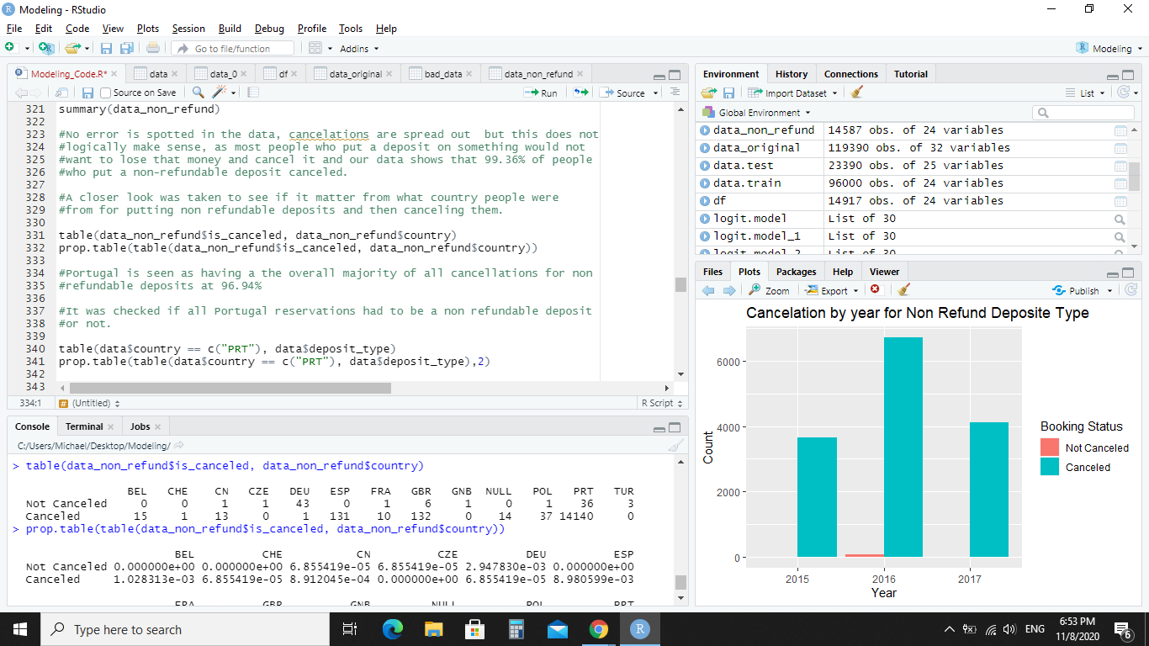
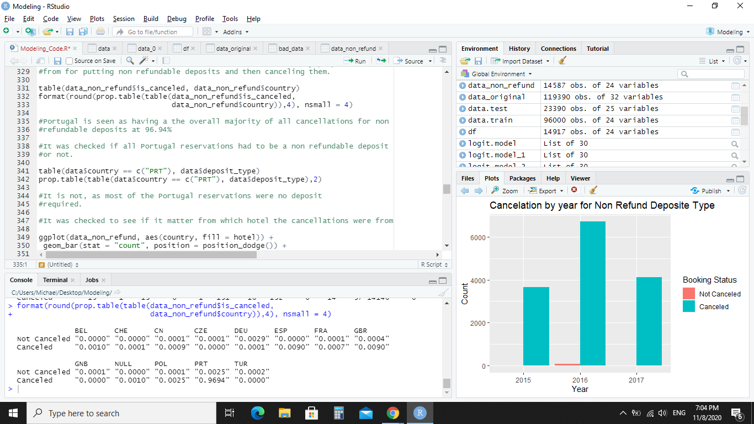
EDA - Deposit type investigated
Next we looked to see if this was an issue based on what country the non deposit reservation was made.
It is seen that Portugal (PRT) has the vast majority of non refundable deposits, 96.93%

Slide 30
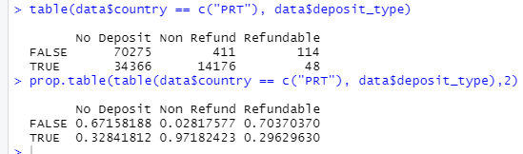
EDA - Deposit type investigated
We checked to see if this was a requirement from Portugal and that all reservations had to be made with a deposit.
This was found to be false. The majority of reservations from Portugal, 34366 to 14176, were made with no deposit needed.
Key
True = the reservations are from Portugal
False = the reservations not from Portugal.

Slide 31
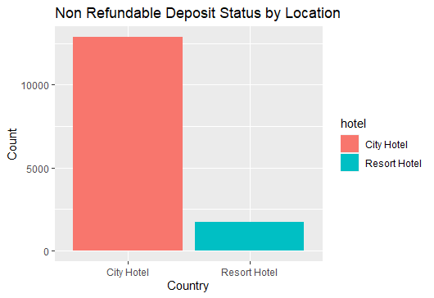
EDA - Deposit type investigated
It is seen that most of the non refundable deposits came from City Hotel and not the Resort Hotel.

Slide 32
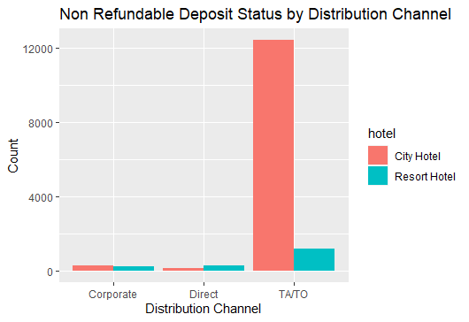
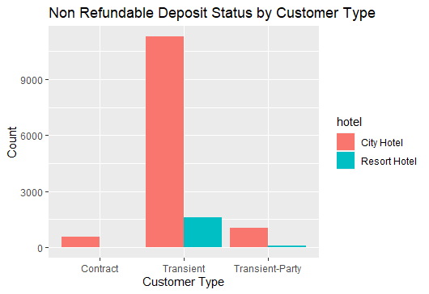
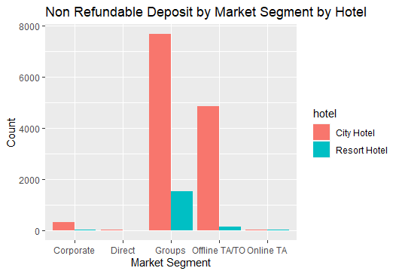
EDA - Deposit type investigated
Most customers that lost their deposit were transient and they booked their tickets through travel agents or tour operators. They also booked as groups or offline, instead of online like most other reservations.

Slide 33
EDA - Deposit type investigated Summary
In this case it is unknown if this is a data entry error or not. It seems unreasonable that so many reservations made with a non refundable deposit, 99.36%, are cancelled.
Added to this, the fact that most of the customers were transient clients 88.50% and almost all of these types of reservations were from Portugal, at 96.93%, makes us question the validity of this variable in our data set.
In a real world situation we would talk to the either our client or our IT department to clarify this issue.
As we can not do this, going forward if it is discovered that deposit_type is a significant data set in our prediction model, we will create two separate models. One with deposit_type, and one without.

Slide 34
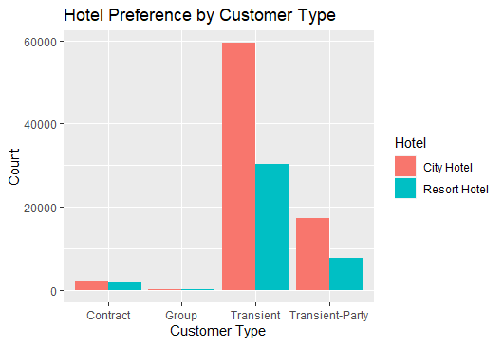
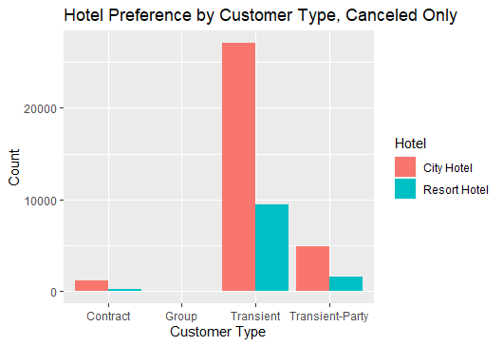
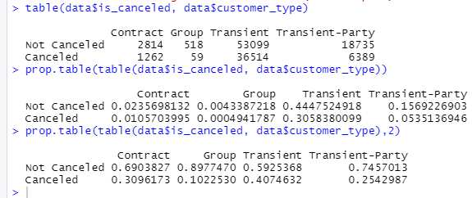
EDA - Hotel Preferences by Customer Type
Most of the customers preference is for the City Hotel, and most of them are also transient. This includes the Resort Hotel meaning they do not have many long staying guests.
If we look at the subcategory of canceled clients and hotel preference, the vast majority of the clients who have canceled also prefer the City Hotel and are transient.
Lastly, the vast majority of overall canceled bookings are transient, at 40.75%.

Slide 35
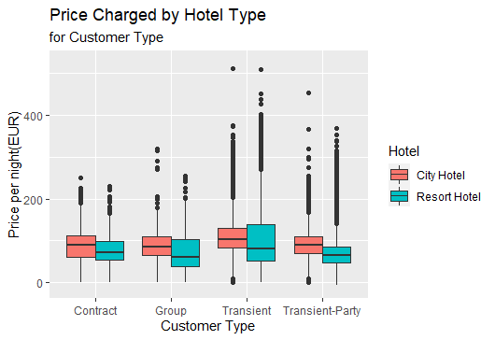
EDA - Price Charged (ADR)
Based on the price per night, customers who were transient were charged on average more than other customers.

Slide 36
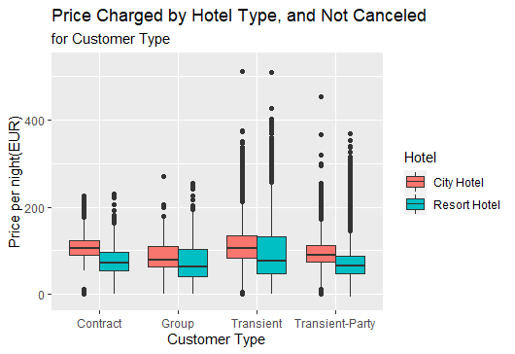
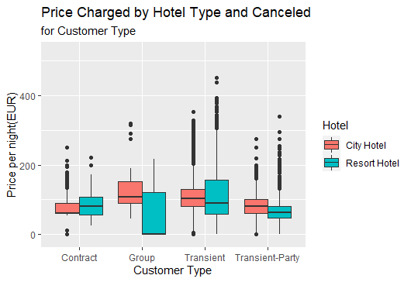
EDA - Price Charged based on Canceled or Not
It was checked to see if there was any relation between the price charged per client type and if the client canceled not.
Besides the canceled group segment from the Resort Hotel, there is no great difference between if a client based on their type and price charged canceled or not.

Slide 37
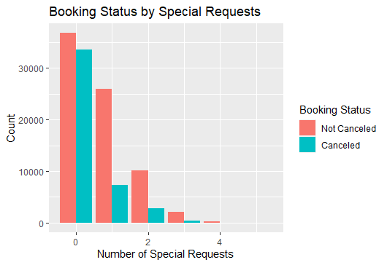
EDA - Cancellations based on Special Requests
Based on special requests data, no special requests was the vast majority of all bookings, and 47.72% of all bookings with no special requests were canceled.
If one special request is made, percentage of cancelations go from 47.72% to 22.02%, while this is still a large rate of cancellations, it is a 25.70% decrease in cancellations.

Slide 38
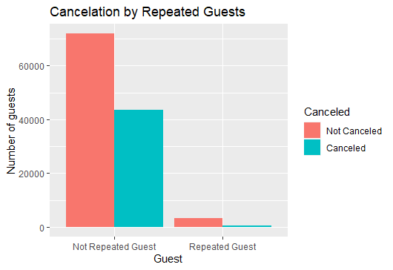
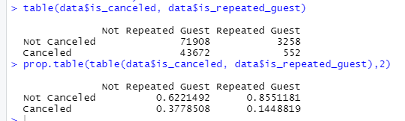
EDA - Repeated Guests
There does not seem to be a relationship between repeat guests and the cancelation rate. If anything repeat guests are 23.34% less likely to cancel their booking.

Slide 39
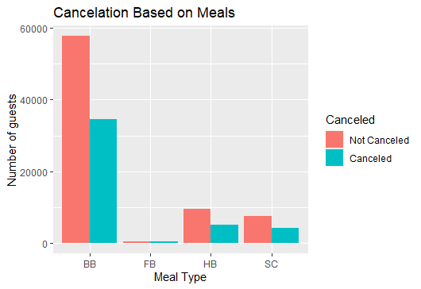

EDA - Meals
In relationship to cancelations and meal type, there are a lot of cancelations with the BB meal. Although it is probably because that meal comes standard with the hotel bookings. This is concluded because there is a small overall number of no meals, of only around 11 thousand.
It is interesting to see that if a client has a FB meal type, they are more likely to cancel at 59.90%.

Slide 40
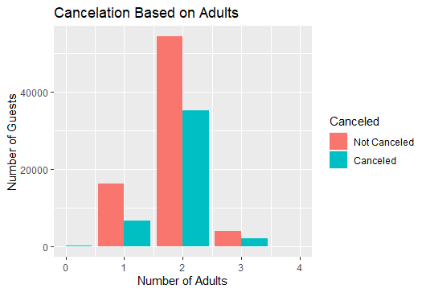
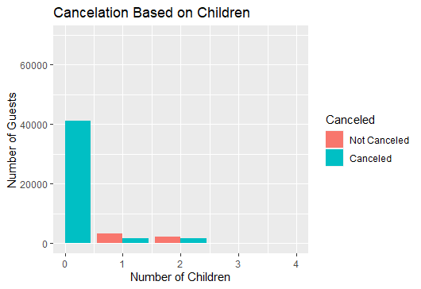
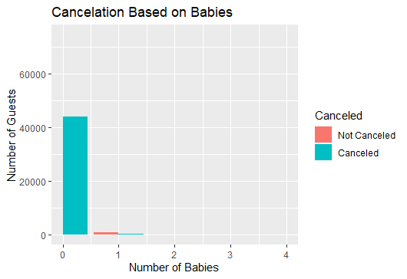
EDA - Adults, Children and Babies
There does not seem to be any connection between the percentage of cancellations and if the client has children or babies with them.
For the adults, most cancellations come from parties that have two adults.

Slide 41
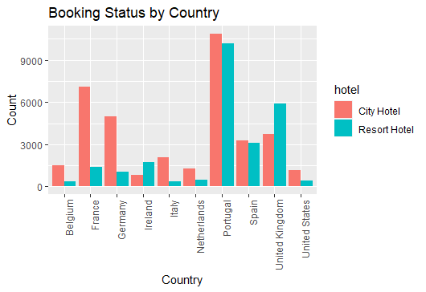
EDA - Non - Cancelers
A subset group of guests who didn’t cancel their reservations was set up in order to see if there was a common trait between them all.
Based on the subset of clients who kept their reservation, 10 countries had more than 1500 people who stayed. An extremely high percentage of the clients the hotels have are from Portugal. This is followed by France, Germany, United Kingdom and Spain.

Slide 42
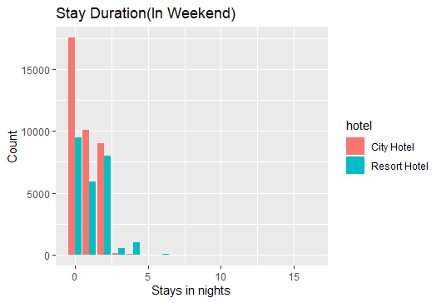
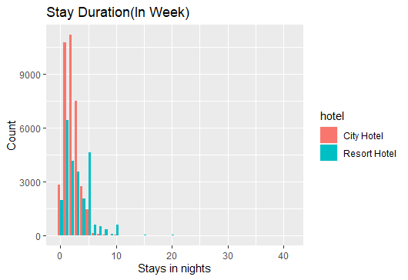
EDA - Duration
The overall duration for number of nights stayed during the weekend averages to one or two nights, and mostly takes place at the City Hotel. For the duration of weekend nights stayed longer than two nights, they are mostly stayed at the Resort Hotel.
The majority of the stays are taken place during the week. They are mostly held at the City Hotel, which makes sense in the context that most travelers are transient clients. Although, at night 5, there is a spike in stays at the Resort Hotel.

Slide 43
Exploratory Data Analysis - Summary
From the analysis of our data the only questionable data we have is with the deposit type. As was stated earlier, we will create two models, one with this data included and one without.
As for possible connections between canceling and not canceling a reservation, there are a few:
The more lead time a client has increases the possibility of cancellation.
Making one change to the booking decreased the possibility of a cancellation.
But, making two changes increased the chance of cancellation in relation to one change. That being said it was still a decrease in relation to no changes.
When the client makes a special request it decreases the chance of cancellation.
Beyond these few connections, there are no obvious connection between cancellations and not canceling.
Other comments we have is that a vast majority of clients are from Portugal, and almost all the non refundable deposits are from there also. A large majority of clients are transient, and prefer to stay at the City Hotel which implies many people pass through there, possibly based on location.

Slide 44
Logistic Regression Model
03.

Slide 45
Deciding the Methodology
The problem we have to try to solve in this project is to figure out if someone will cancel their reservation or not.
The dependent variable is dichotomous(canceled & not canceled)
Therefore, our group decided to use a logit model to try to model our data set.

Slide 46
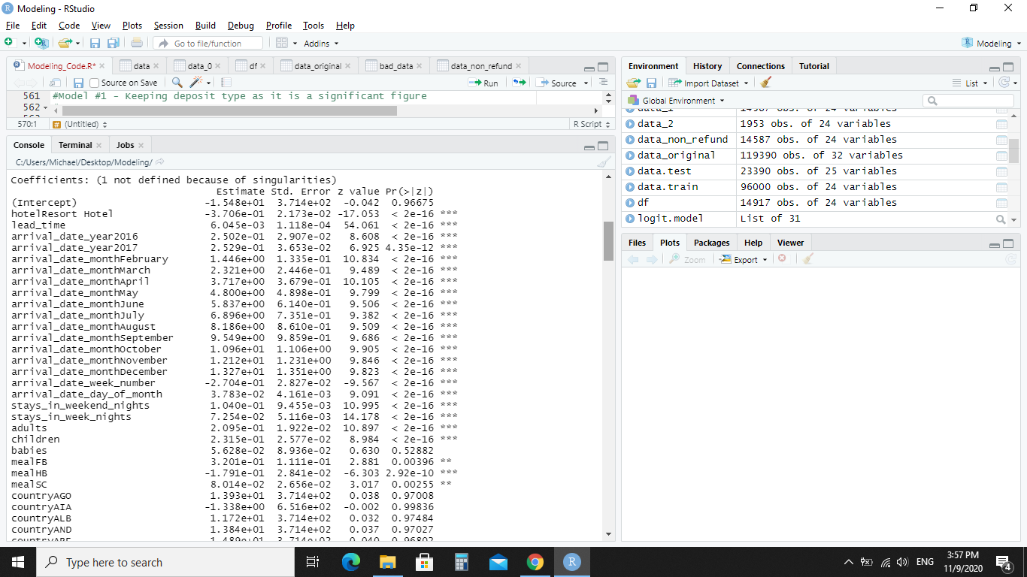


Model Version 1
Including deposit type
Model Creation - Step 1
The glm() model was used to run the whole data set to find the values that were considered significant.
The first model kept all the variables, including the ones that had some subvalues that were not significant. For example reserved_room_type has some values, reserved_room_typeL that is not significant, but it has at least one subvalue that is significant.

Slide 47


Model Creation - Step 2 - 5
We then checked for multicollinearity but received this error:
We proceed to run the alias function with the variables from our data set and discovered that assigned_room_type was the culprit. This was removed from our next model and this process was run again.
We continued to do this for multiple steps. Creating the model checking the summary of it for new non-significant variables and removing them.
At the same time we would check for multicollinearity and remove the variables one by one if they were higher than 5. We started with the highest numbers first to see if that reduced the multicollinearity of the lower numbers without needing to remove them from the data set..

Slide 48


Model Creation Step - 6
After many iterations our 5th model has only significant values and all of its vif values are less than 5, meaning there is no multicollinearity.
We also removed our arrival_date_year variable, even though it was significant we decided it logically did not make sense to train the model on this as the type of this variable is actually the date, it shows the bookings of the last three years but we want to predict the bookings for the coming years.
We then created two subsets of our data, one to train the model on and one to test it on.

Slide 49

Model Creation Step - 7
We then trained the model, set up the output values as binomial, “Canceled”, “Not Canceled”, and ran a calculation of its prediction accuracy.
After running the model we only have a prediction accuracy of around 51%, we returned to our model summary to see if there was an error in our inputs of variables, which there wasn’t.
We also went back to our data exploration process to see if we could find a variable that we should include based on our intuition that was removed. After discussing it and trying out different variables there was no other variable we found that could improve our prediction.

Slide 50

Model Creation Step - 8
We tried to figure out where exactly our model did so poorly. We looked into the breakdown of where it correctly guessed when a booking is canceled and where it correctly guessed when a booking was not canceled.
The rows on the tab is the real data from our test data. 23,369 (11547+11822) bookings were not canceled. While 21 (0 + 21) bookings were canceled.
The columns are the predictions that our model made. Our model did not correctly predict a single canceled bookings. While it correctly predicted 50.59% of all not canceled bookings.
This is close to our models prediction accuracy of 51%.
It seems that our model falsely identifies bookings as canceled when they should not be identified as canceled.

Slide 51


Model Version 2
Removing deposit type
As stated earlier, due to the uncertainty of the validity of the data from the variable deposit_type, we created a second model that did not include this variable.
We created a sub data set without the variable deposit_type and trained it on that and tested it out in the same way as our first model.

Slide 52

Model Version 2
Removing deposit type
Our model without this data is actually worse off, we only have a prediction accuracy of 42%.
From this we see that removing this, even if it is incorrect data, decreases our model accuracy by 9%.

Slide 53
Conclusions 04.

Slide 54
Recommendations and thoughts
Based on our analysis and the creation of our best model, we only have a success rate of 51% to predict if someone will cancel or not cancel their reservation. If we are honest this is not much more better than a 50/50% rate of correctly guessing a flipped coin.
This being said, we do have suggestions to improve the model through more data collection. We suggest that the Hotels get customers to fill out a questionnaire about why they canceled their reservation. This direct information could help us improve the model and help the hotels directly understand why the client cancelled and reduce the rate.
There also seems to be some connections between cancellations and lead time, special requests, and booking changes.
On average, the clients who have a longer lead time between booking the hotel and their arrival date are more likely to cancel. The hotel should try to come up with an incentive for customers with long lead times to not cancel.
Booking customers who make at least one special request greatly reduces their cancellation rate by 25.70%. The hotel should try to find a way to get clients to add a special request, while this may increase the work for their staff, it could overall increase their total income.
Lastly, making one change to a booking reduces the cancellation rate from 40.85% to 14.23%. Although, we do not know if the changes made are coming from the hotel or the customer. We suggest that the hotel updates the data tracking to include that as the 14.23% cancellation rate could be coming from changes made by the hotel itself instead of the client.
We hope our insights and suggestions will help decrease the cancellation rate of clients and improve the hotel experiences.

Slide 55
THANKS!

